Slide 1






PDEU & PDPU IIC BRINGS TO YOU
LET'S HACK 4.0!
ELECTRIC MOBILITY
ENERGY STORAGE SYSTEM
Pre-Finale/Finale
Team No: 40
PS NO. : 01
PS: Prediction of Remaining Useful Live of EV
Batteries using AI and ML algorithm
Let’s Hack 4.0: Electric Mobility and Energy Storage Systems

Slide 2
Name/ Tagline of the Idea
PORTEND
We predict, You benefit
Let’s Hack 4.0: Electric Mobility and Energy Storage Systems
Notes:
summary of what you do

Slide 3
Problem(s) Being Addressed
Most electric vehicles use lithium-ion batteries as energy storage system. As this battery technology shows degradation during service life, lifetime analyses are of interest to understand aging phenomena and to optimize batteries and their operation.
Remaining Useful Life(RUL) of EV batteries is predicted so that we can replace these batteries before total breakdown and hence increasing the reliability of vehicle.
Let’s Hack 4.0: Electric Mobility and Energy Storage Systems

Slide 4
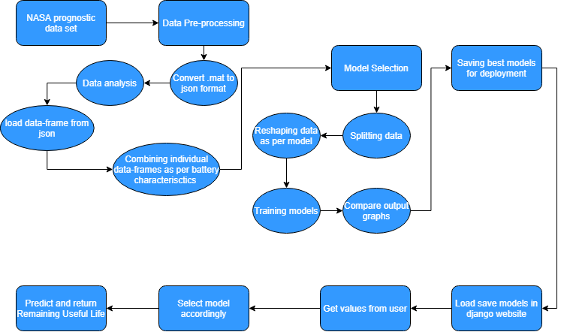
Solution
Let’s Hack 4.0: Electric Mobility and Energy Storage Systems
Notes:
Solution is not a product. “How will you solve the problems”

Slide 5
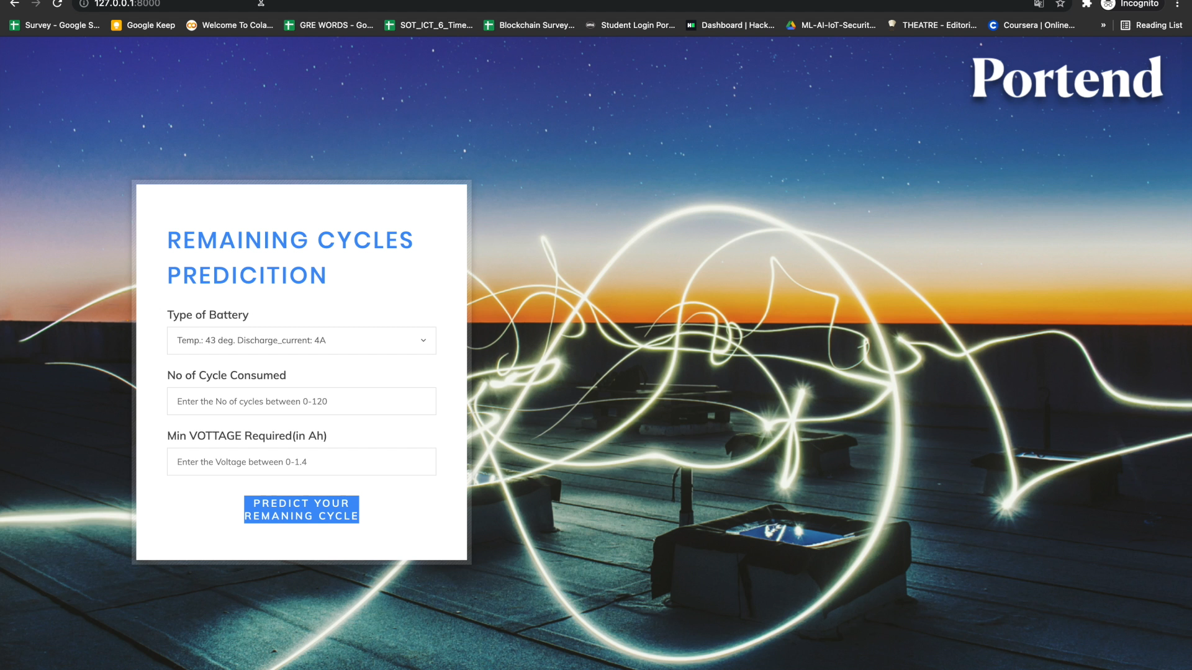
Solution
Let’s Hack 4.0: Electric Mobility and Energy Storage Systems
Notes:
Solution is not a product. “How will you solve the problems”

Slide 6
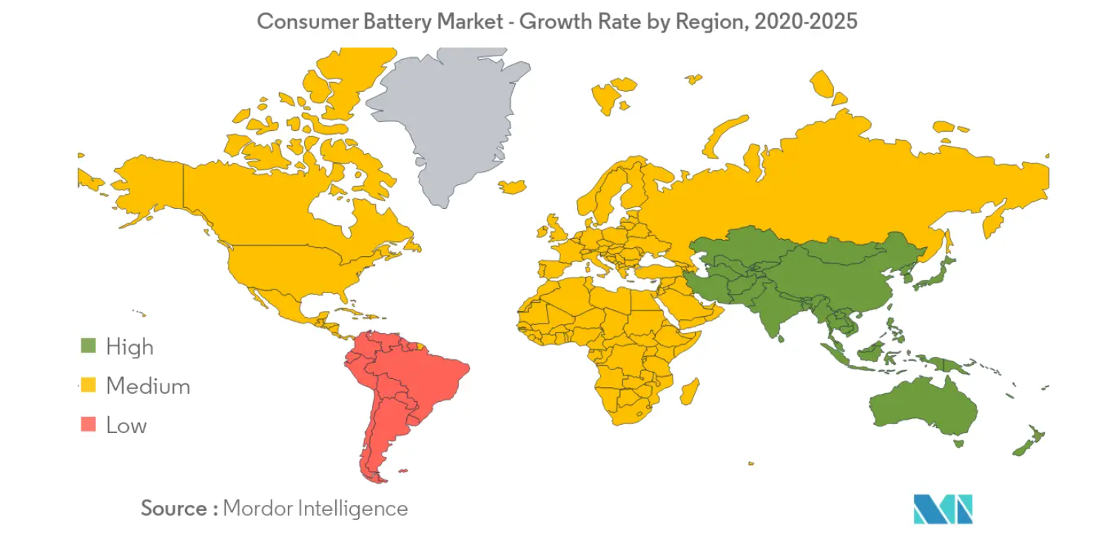
Core Customers
Let’s Hack 4.0: Electric Mobility and Energy Storage Systems
Notes:
Whose problem is it? Whom are you going to sell?

Slide 7
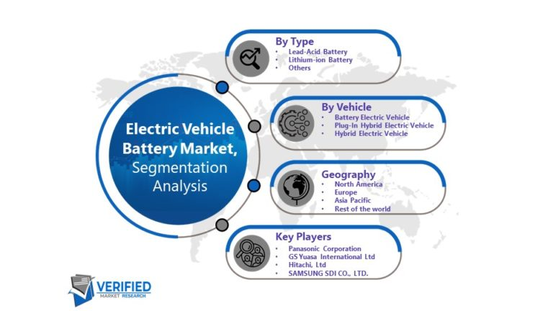
Core Customers
Let’s Hack 4.0: Electric Mobility and Energy Storage Systems
Notes:
Whose problem is it? Whom are you going to sell?

Slide 8
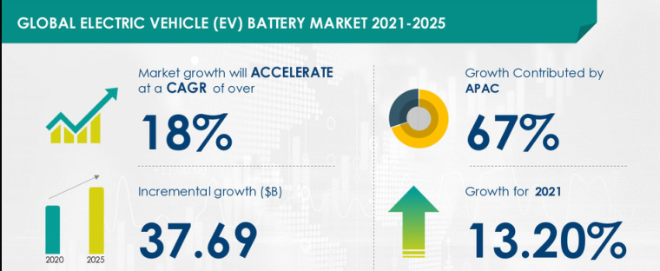
Market Analysis
Let’s Hack 4.0: Electric Mobility and Energy Storage Systems
Notes:
Whose problem is it? Whom are you going to sell?

Slide 9
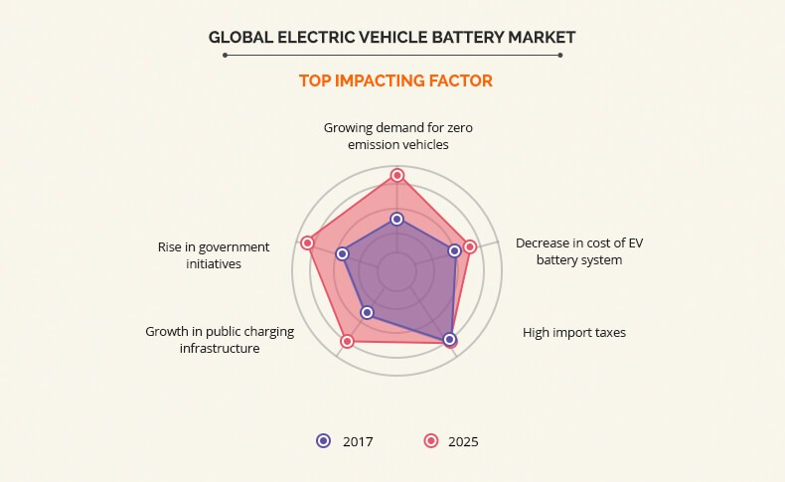
Market Analysis
Factors impacting the Electric Vehicle Battery market and favoring us:
Rising demand for zero emission vehicles
Reduction in costs of EV battery system
Public charging infrastructure has seen a significant growth
Governments are taking a lot of initiatives to promote use of EV
Let’s Hack 4.0: Electric Mobility and Energy Storage Systems
Notes:
Whose problem is it? Whom are you going to sell?

Slide 10
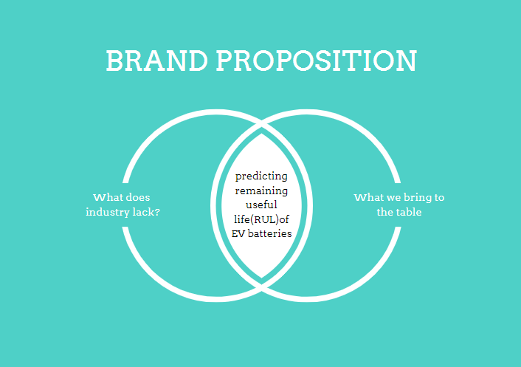
Unique Value Proposition
Let’s Hack 4.0: Electric Mobility and Energy Storage Systems
Notes:
What is the value you bring in? Tool: Value Proposition Canvas

Slide 11
Product Information Slide
We have made a perfectly running and ready-to-use prototype that predicts the Remaining Useful Life(RUL) of EV battery using different AI algorithms.
Algorithms used:
SVM(Support Vector Machine)
XGBoost(Extreme Gradient Boost)
RVM(Relevance Vector Machine)
Best Algorithm: RVM
Let’s Hack 4.0: Electric Mobility and Energy Storage Systems
Notes:
(visual representation) Screenshots (mockups) - Real world images/ the videos/ Diagrams/ Mockups Service business (case studies/ before and after comparison)

Slide 12
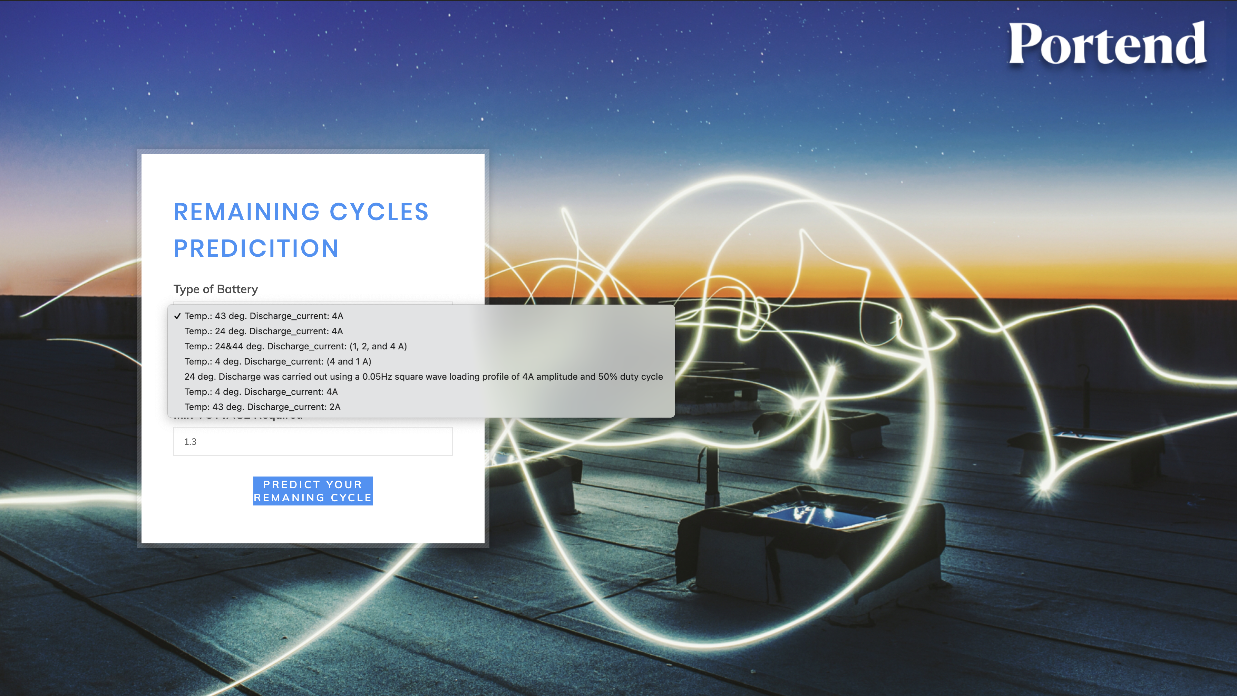
Product Information Slide
Let’s Hack 4.0: Electric Mobility and Energy Storage Systems
Notes:
(visual representation) Screenshots (mockups) - Real world images/ the videos/ Diagrams/ Mockups Service business (case studies/ before and after comparison)

Slide 13
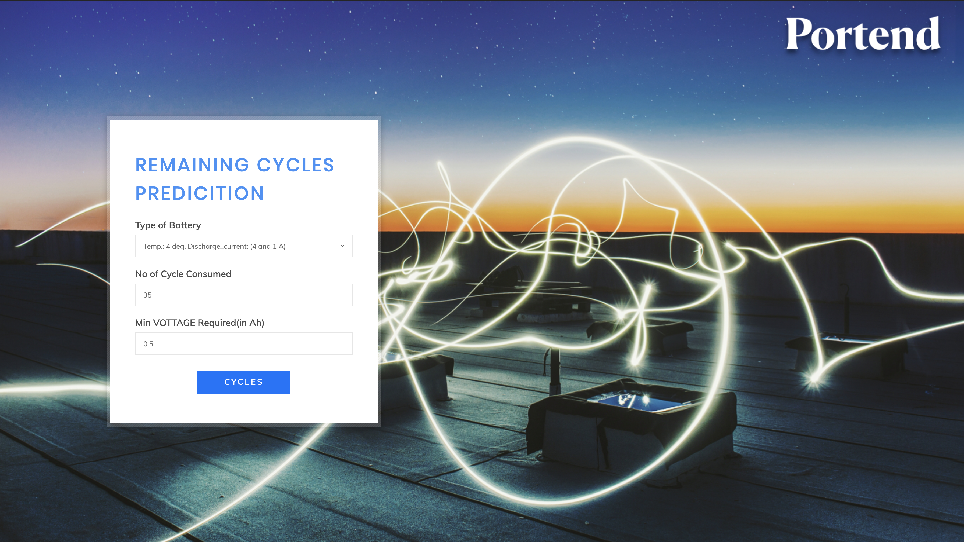
Product Information Slide
Let’s Hack 4.0: Electric Mobility and Energy Storage Systems
Notes:
(visual representation) Screenshots (mockups) - Real world images/ the videos/ Diagrams/ Mockups Service business (case studies/ before and after comparison)

Slide 14
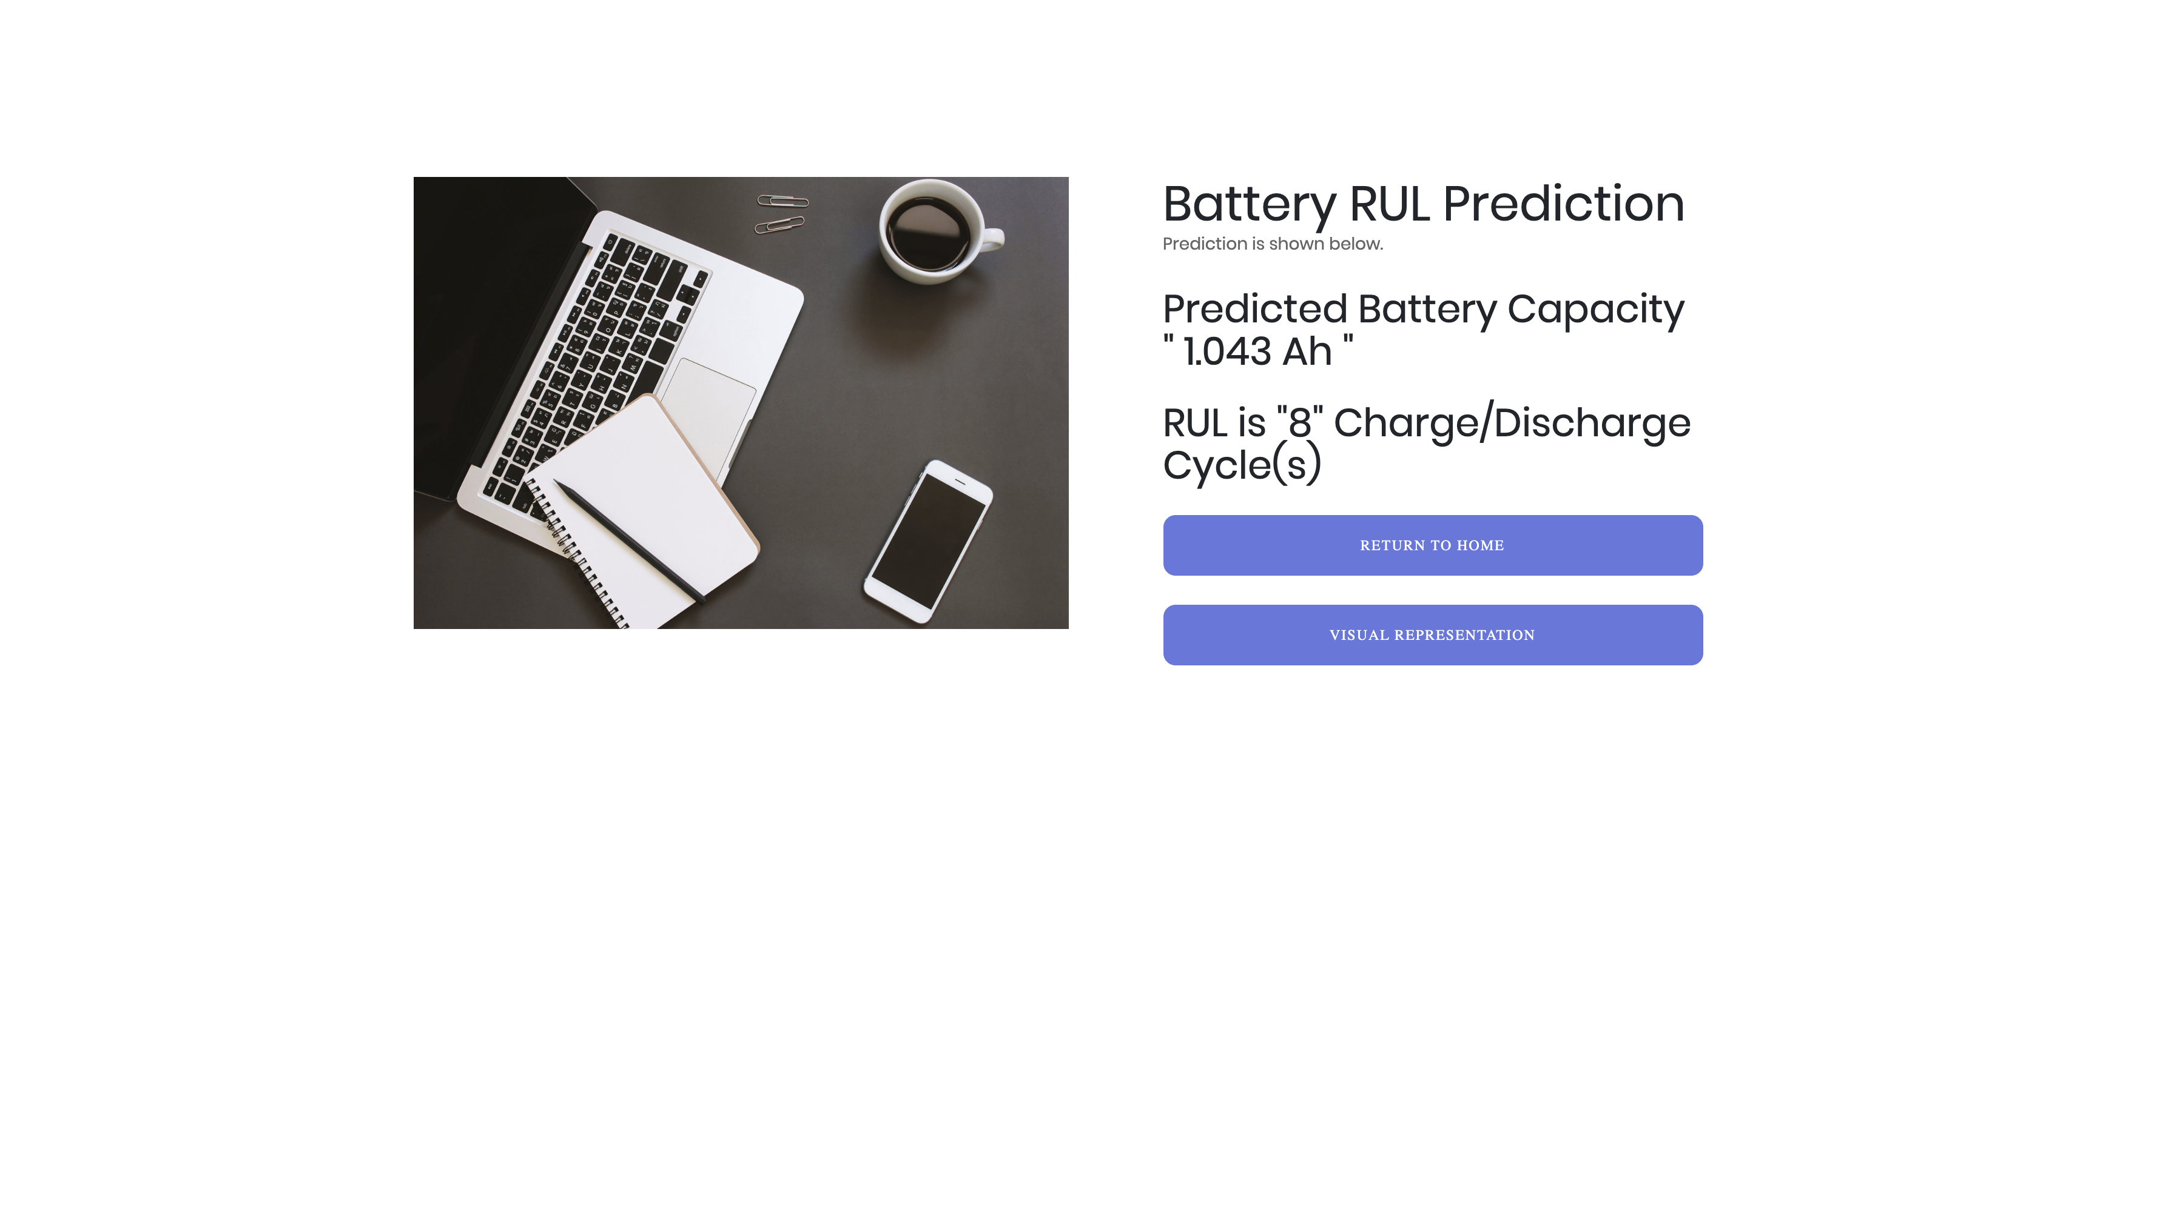
Product Information Slide
Let’s Hack 4.0: Electric Mobility and Energy Storage Systems
Notes:
(visual representation) Screenshots (mockups) - Real world images/ the videos/ Diagrams/ Mockups Service business (case studies/ before and after comparison)

Slide 15
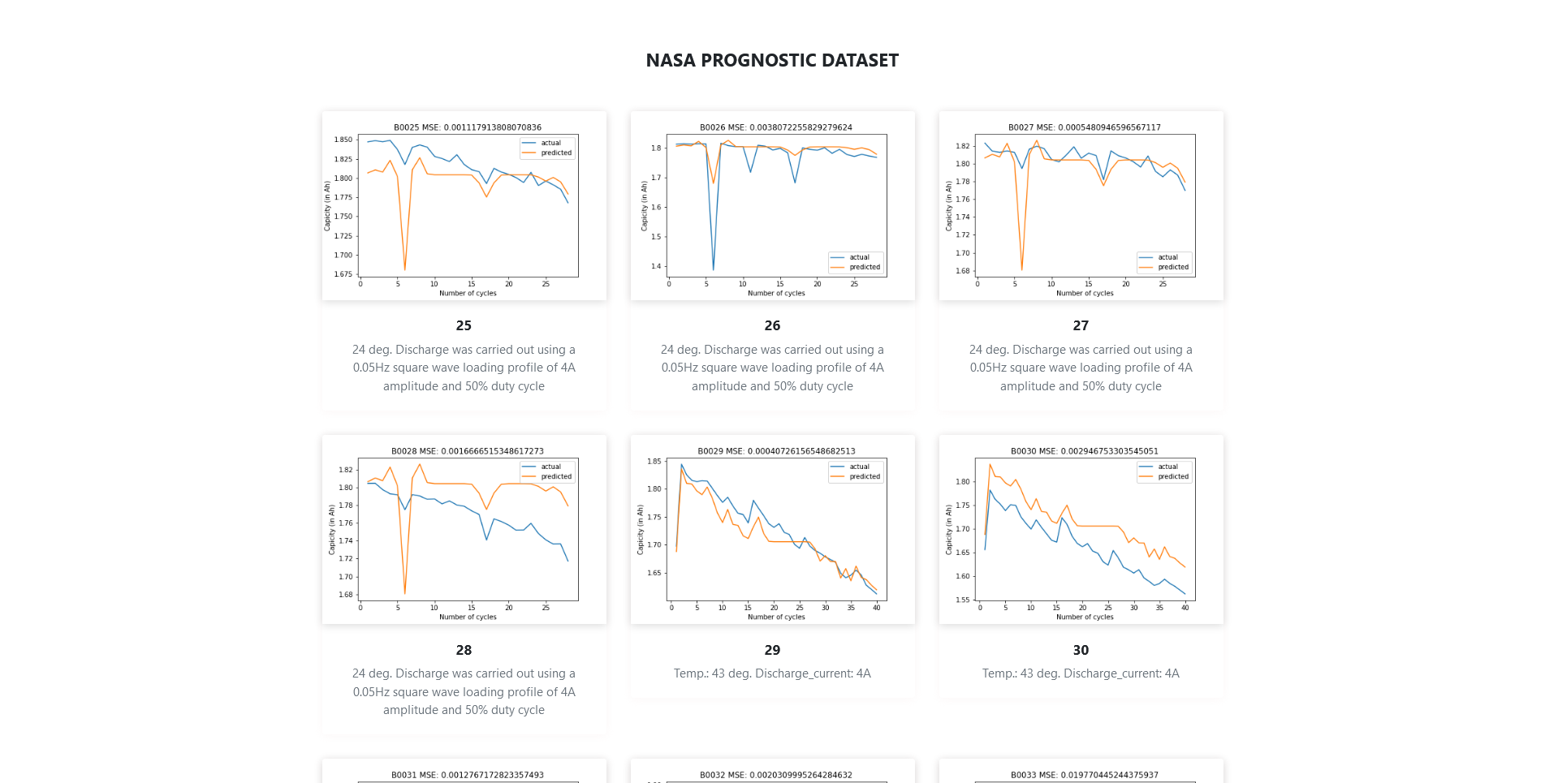
Product Information Slide
Let’s Hack 4.0: Electric Mobility and Energy Storage Systems
Notes:
(visual representation) Screenshots (mockups) - Real world images/ the videos/ Diagrams/ Mockups Service business (case studies/ before and after comparison)

Slide 16
Competition
Previously, researchers have tried to predict Remaining Useful life(RUL) of EV batteries using different methods.
However, a product identifying the RUL of batteries hasn’t been made yet on a commercial scale.
We have developed a unique product that solves a major issue of the industry.
Let’s Hack 4.0: Electric Mobility and Energy Storage Systems
Notes:
Direct/ indirect Competition

Slide 17
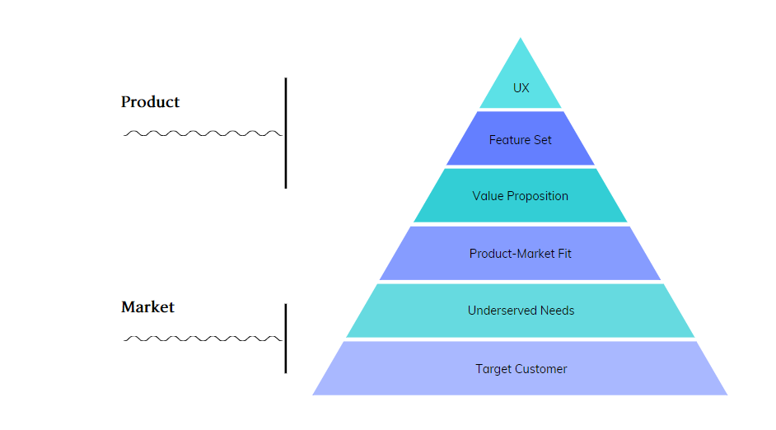
Business Plan
Simplistic User experience
Easy to get features for prediction
Maintaining Batteries with ease
Increasing battery usage due to upsurge in EV
Easy-to-use battery monitoring service
Personal and Industrial battery owners
Let’s Hack 4.0: Electric Mobility and Energy Storage Systems
Notes:
Operating Plan/ Business Plan/ Roadmap/ Product Roadmap

Slide 18

Team
Let’s Hack 4.0: Electric Mobility and Energy Storage Systems
Notes:
Team: What do you do now + What you have done? (diverse background)

Slide 19


THANK YOU!
Let’s Hack 4.0: Electric Mobility and Energy Storage Systems

